Slide 1
 | Graduation Routes Other Ways Principal: Mark Lewis mark.lewis@sd27.bc.ca PH: (250) 396 – 7230 https://www.sd27.bc.ca/grow
Newsletter – April 2024
Grow Office Hours
Mon-Thurs: 8:00am – 3:00pm
Fri: 8:00 – 12:00
Report Cards Report cards were mailed home before spring break. They are also available in the MyEducation BC parent portal. Please contact GROW if you have not been able to access your child’s report card. If you have any questions or concerns about report cards, email Jillian at jillian.eyer@sd27.bc.ca
Term 3 Planning
Please check through your curriculum packages and make sure you have everything you need to get started on term 3. Curriculum outlines/learning plans are available on GROW’s website at Grades K - 7 Learning Plans (sd27.bc.ca). If you find you need a resource, contact Jillian. Work submissions for term three are due on June 1st.
April 19th Event
Our next GROW field trip will be on April 19th and will be held in the south end of our school district, in the 108 Mile House area. We will be touring a local fire department and doing some outdoor learning in the afternoon. There will also be a general PAC meeting on this day. We look forward to you joining us for this event!
The Mighty Quinn Show GROW students are invited to Mile 108 Elementary on Friday, April 15th for “The Mighty Quinn Show.” This performance is part of the Art Initiative in Schools and runs from 8:30-9:30 am. An email was sent to families with information. It looks like a terrific show and we hope some of you can make it!
Please ring the doorbell (left of the door by the parking lot) when you visit the school and sign in at the office

Slide 2
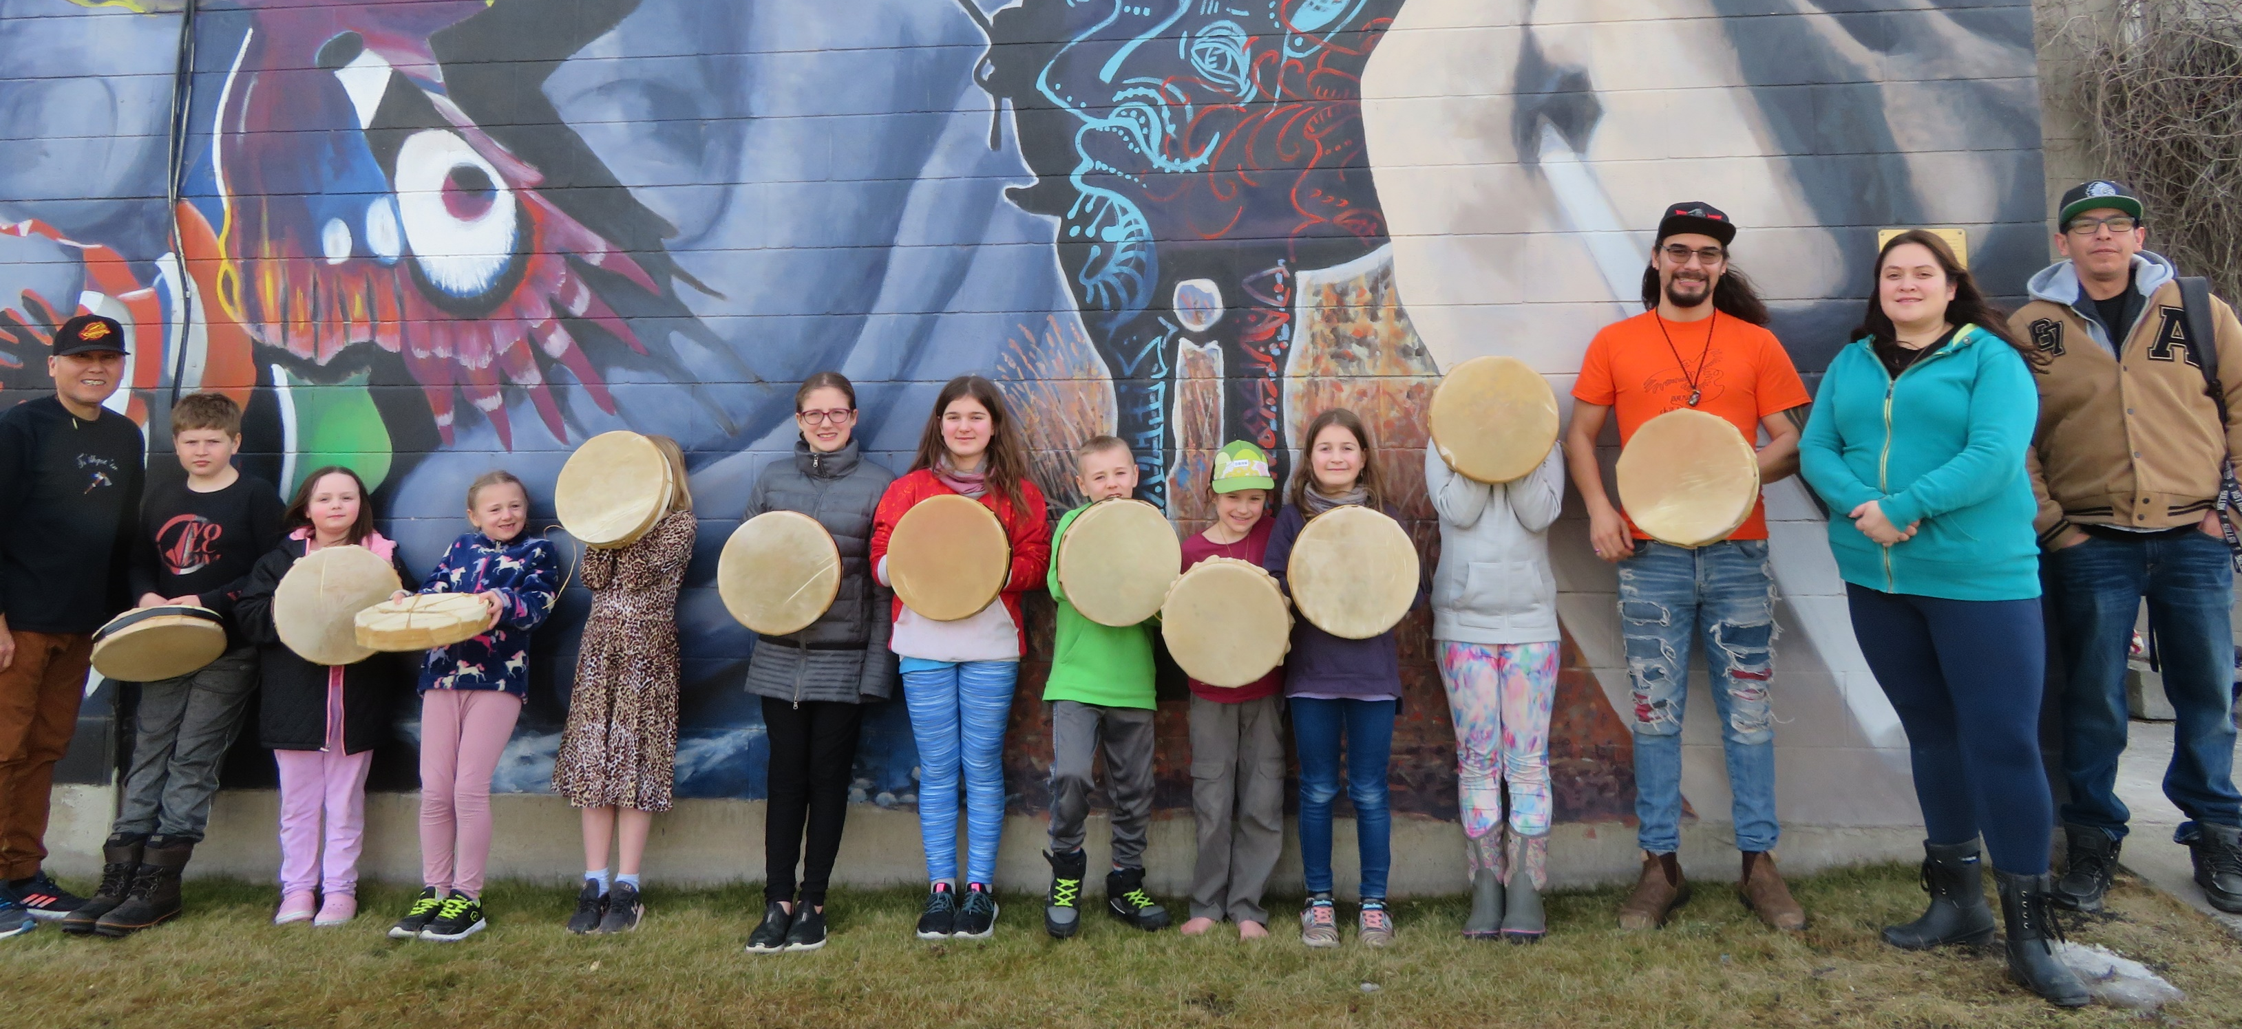
March 8th Event
Many of our students participated in our March 8th event. Students got a music lesson from LeRae Haynes and got the opportunity to develop their ukulele skills. Our older students worked with members of the Denisiqi Services Society to build their very own drums, and our younger students learned how to do some beading with Ada Phillips from the Xatśūll First Nation. We also headed over to Marie Sharpe Elementary for some gym time led by a couple of our PAC members, and enjoyed a pizza lunch provided by the PAC. It was a memorable day with lots of learning and connecting with others!
Watershed Presentation If GROW students can be invited to this event on April 15th, perhaps a few details could be shared with families here?
Ongoing Access to Community Services
We just wanted to remind everyone, and let new enrollments know, about our agreements with community organizations for GROW students:
Swimming – GROW students may swim free from 9:00am-3:00pm, Mon-Fri at the pool in Williams Lake.
Gym Time – if you would like gym time, let us know! The gym at Lac La Hache Elementary can be made available for GROW students starting at 2:00pm on school days. Gym time has to be booked in advance.
Drop-In at GROW – We continue to have a drop-in day for GROW students every Friday. Come by if you’d like some extra support, a resource, or would just like to show your face and say hi!

