Slide 1
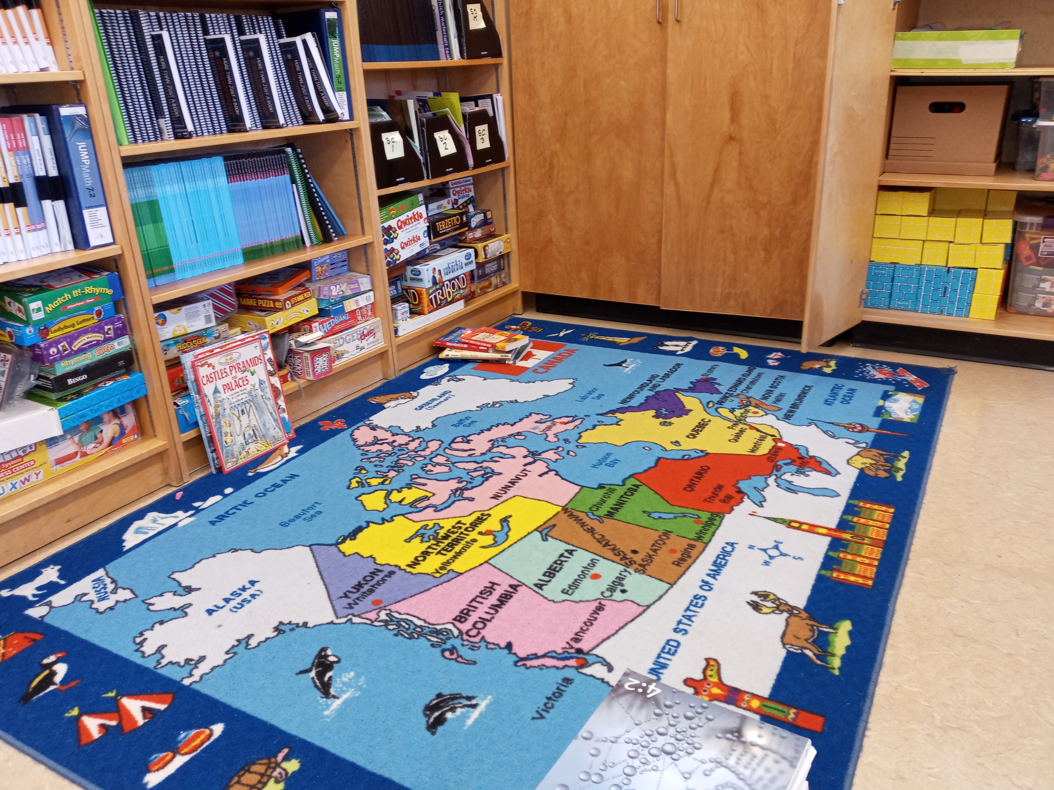
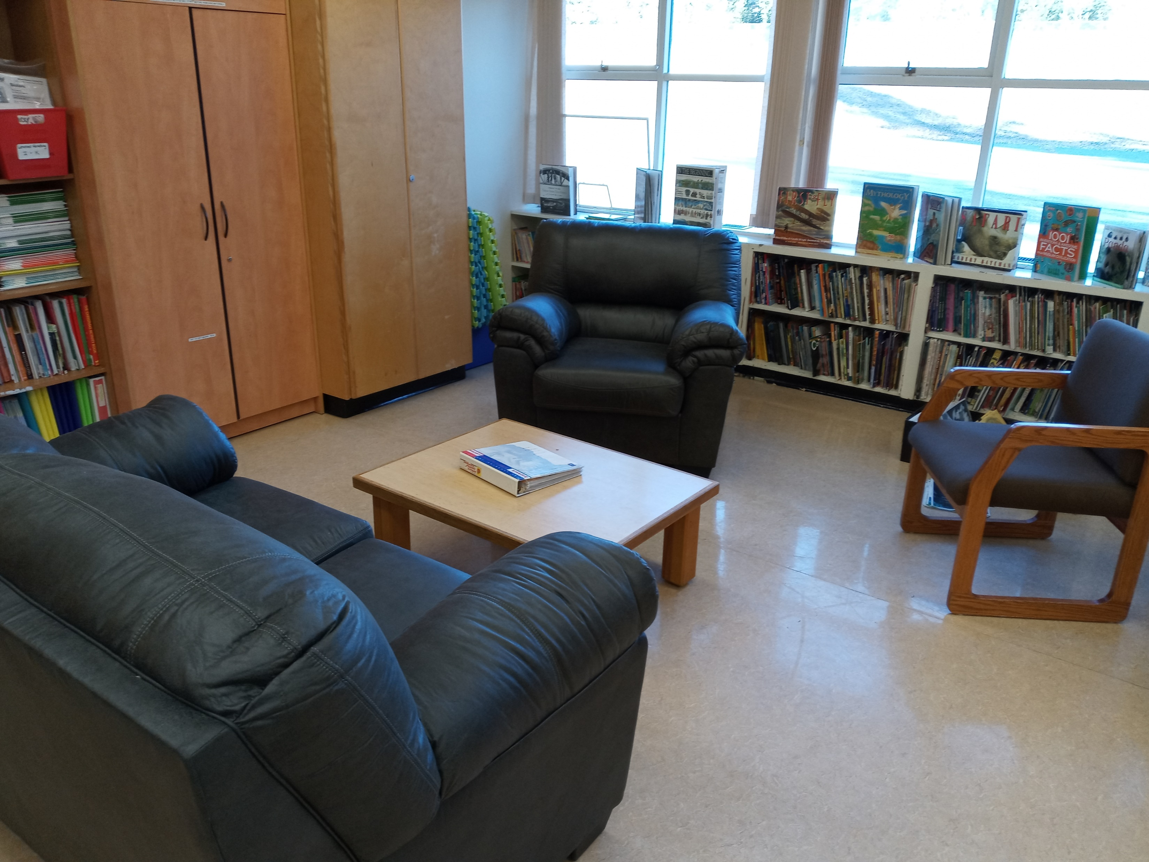
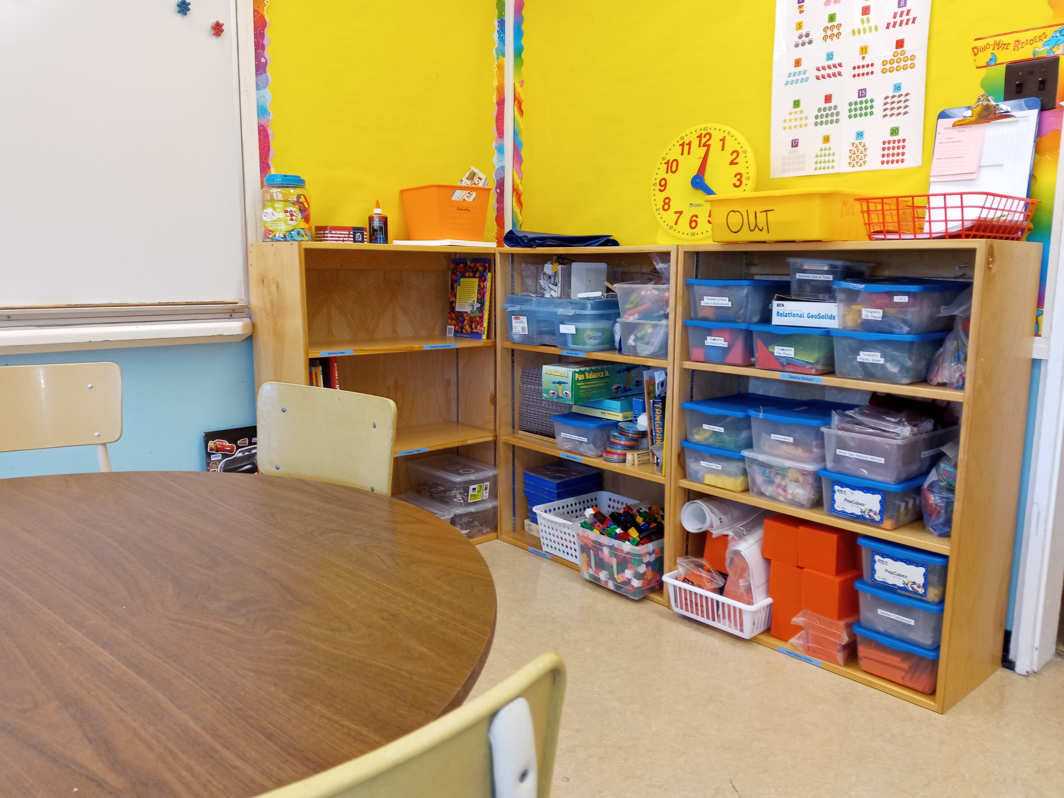
 | Graduation Routes Other Ways Principal: Mark Lewis mark.lewis@sd27.bc.ca PH: (250) 396 – 7230 https://www.sd27.bc.ca/grow
Newsletter – November 2023
We Would Love to See You!
We are working to make GROW a welcoming space and would love for you to stop by for a visit! We now have some comfy furniture, a space for floor play (plus toys and games!) and a table area for work and art. Thank you to those who completed the survey about how best to use our space!
Drop-In Fridays
Starting on November 24th, GROW will be open for drop-in visitors every Friday. You can arrange to meet with other families, come to get extra support, or to work with Jillian and all the resources we have available.
Theme Weeks
Every few weeks, we’ll choose a different theme to explore through displays and activities here at GROW. You can make an appointment or come in on a drop-in day to experience our current theme. Sometimes we’ll invite experts in too! Jillian will let you know the current and upcoming themes in her Monday Memo. If you have an idea for a theme you’d like to see, please let her know.
Grow Office Hours
Mon-Thurs: 8:00am – 3:00pm
Fri: 8:00 – 12:00
Please ring the doorbell (left of the door by the parking lot) when you visit the school and sign in at the office.

Slide 2
Remembrance Day
Our first theme at GROW will be Remembrance Day in the first two weeks of November. Students have the opportunity to complete a piece of art and contribute to a recorded audio presentation. They can do this at home or come to GROW and we will do it together. Lac La Hache will not be having a traditional assembly, so our presentation will be shared with GROW families.
Reading Assessments
Reading assessments are underway. You should have received the book/article and assignment by email. Please let Jillian know if you have any questions or concerns. She will contact you to set up a time for your child to read to her.
Kindergarten Screening
One of the district’s speech language pathologists has kindly offered to screen our kindergarten students. Every year, students in kindergarten are screened for speech language difficulties. GROW students are entitled to this service as well. Please let us know if you want your child screened.
Wild & Immersive Field Trip
You should all have received information about the Wild & Immersive field trip by now. We are looking forward to learning with you on November 17th!
Brightspace
Grade 5, 6, and 7 students have been enrolled in their very first Brightspace course! Our intermediate students will be doing PE through Brightspace this year. This online learning platform has been widely adopted across BC. We welcome your feedback as we gradually roll out this new system.
Term 1 Work Submissions
Can you believe that we are already thinking about term 1 report cards here at GROW? It feels like the school year just got started. Please have your term 1 work submitted by December 1st so report cards can be written and released before winter break. Make sure you check the curriculum/learning plan to see what needs to be submitted, and as always, ask if you need clarification.

