Slide 1
 | Graduation Routes Other Ways Principal: Mark Lewis mark.lewis@sd27.bc.ca PH: (250) 396 – 7230 https://www.sd27.bc.ca/grow
Newsletter – May 2024
Grow Office Hours
Mon-Thurs: 8:00am – 3:00pm
Fri: 8:00 – 12:00
File Verifications for 2024/25 School Year
2024/25 Registration for GROW
If your child is currently enrolled in GROW, their registration will automatically carry over to the 2024/25 school year, unless they are in grade 7.
Leaving GROW? – grade 7s and other students transferring out of GROW will need to register at their new school to have their file and enrolment transferred for next year. Please let the school know if you need any assistance with transferring—we are happy to help make things as smooth as possible
Coming to GROW – upcoming kindergarten students and other students transferring into GROW can complete their registration for the 2024/25 school year now. If you know of any families in this position, please let them know—it gives us a better idea of our numbers for next year.
School Photos A photographer will be at Lac La Hache Elementary on Wednesday, May 8th to take class photos. If you would like to be included in a class photo, please plan to arrive at 10:00am. Please note that these are not individual photos. The photographer will only be doing class/school photos on this day. It’s a good idea to call ahead if you are planning on joining.
Please ring the doorbell (left of the door by the parking lot) when you visit the school and sign in at the office

Slide 2
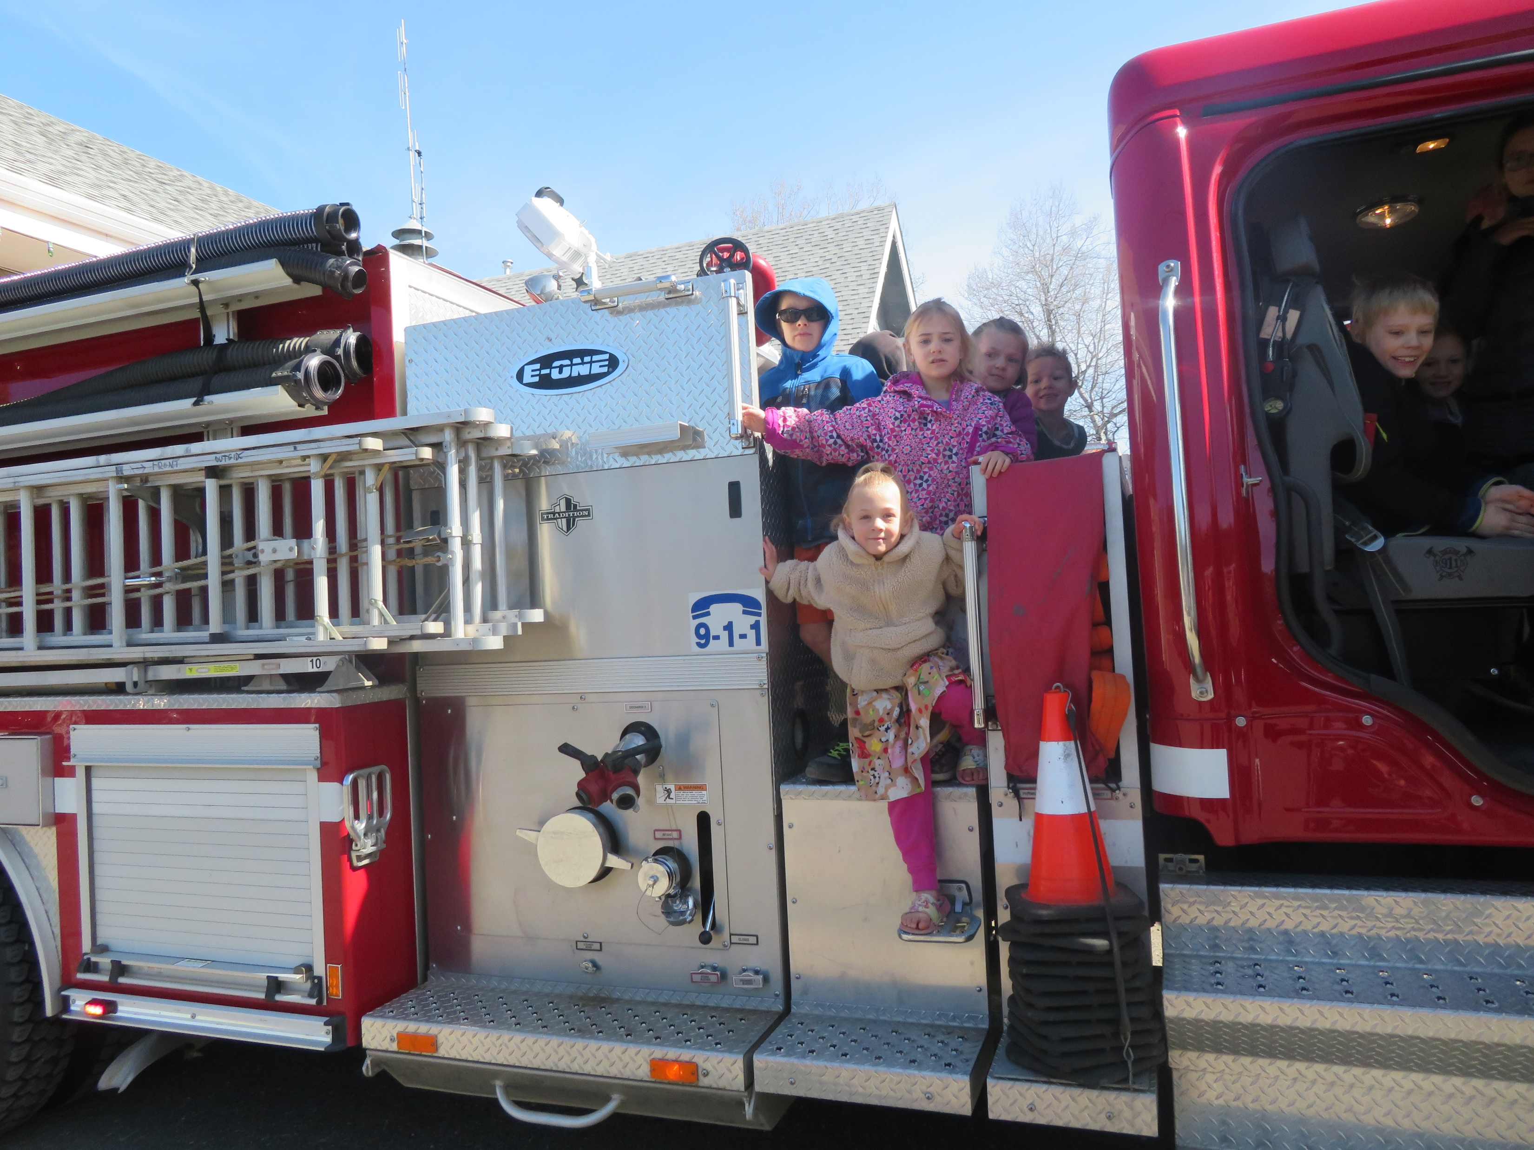
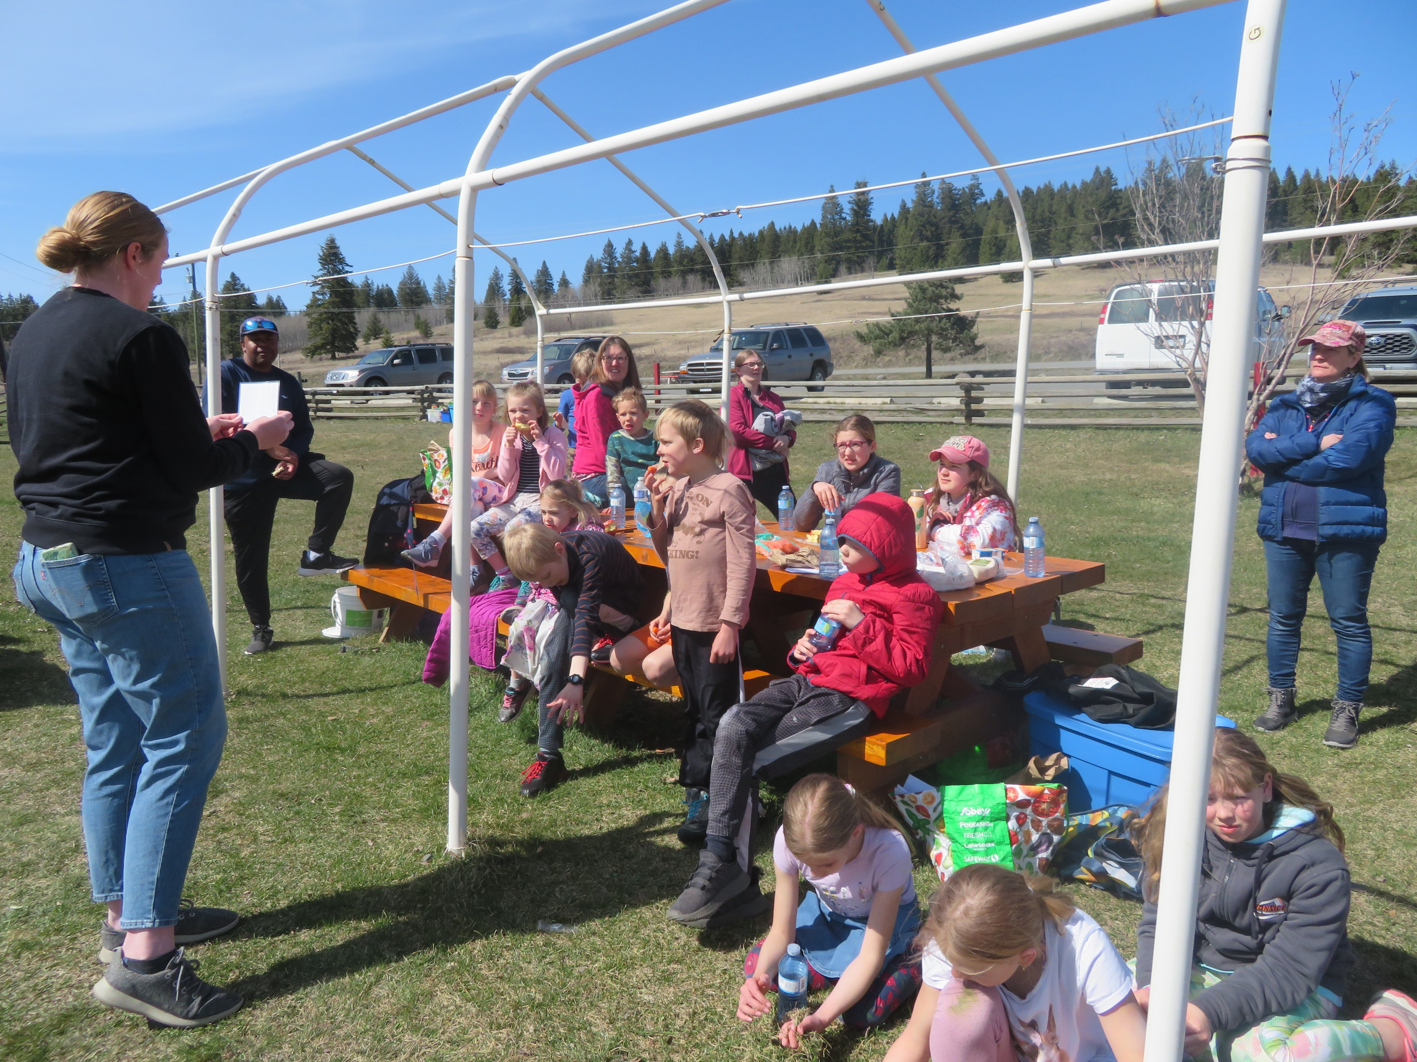
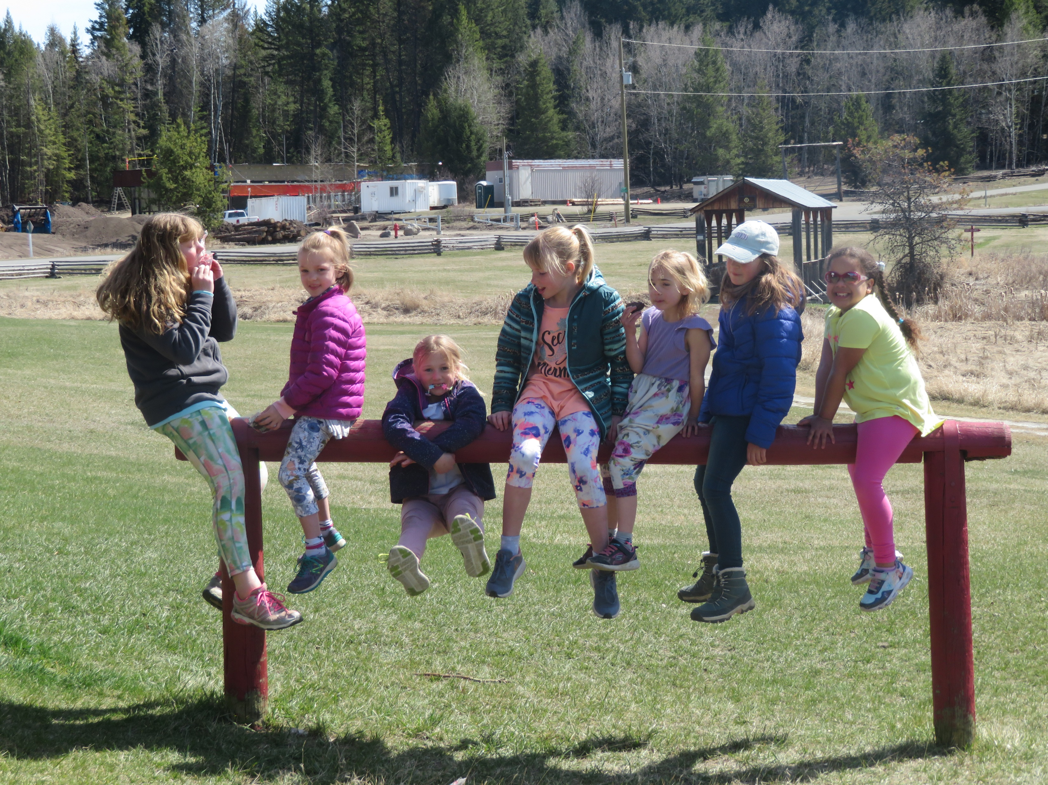
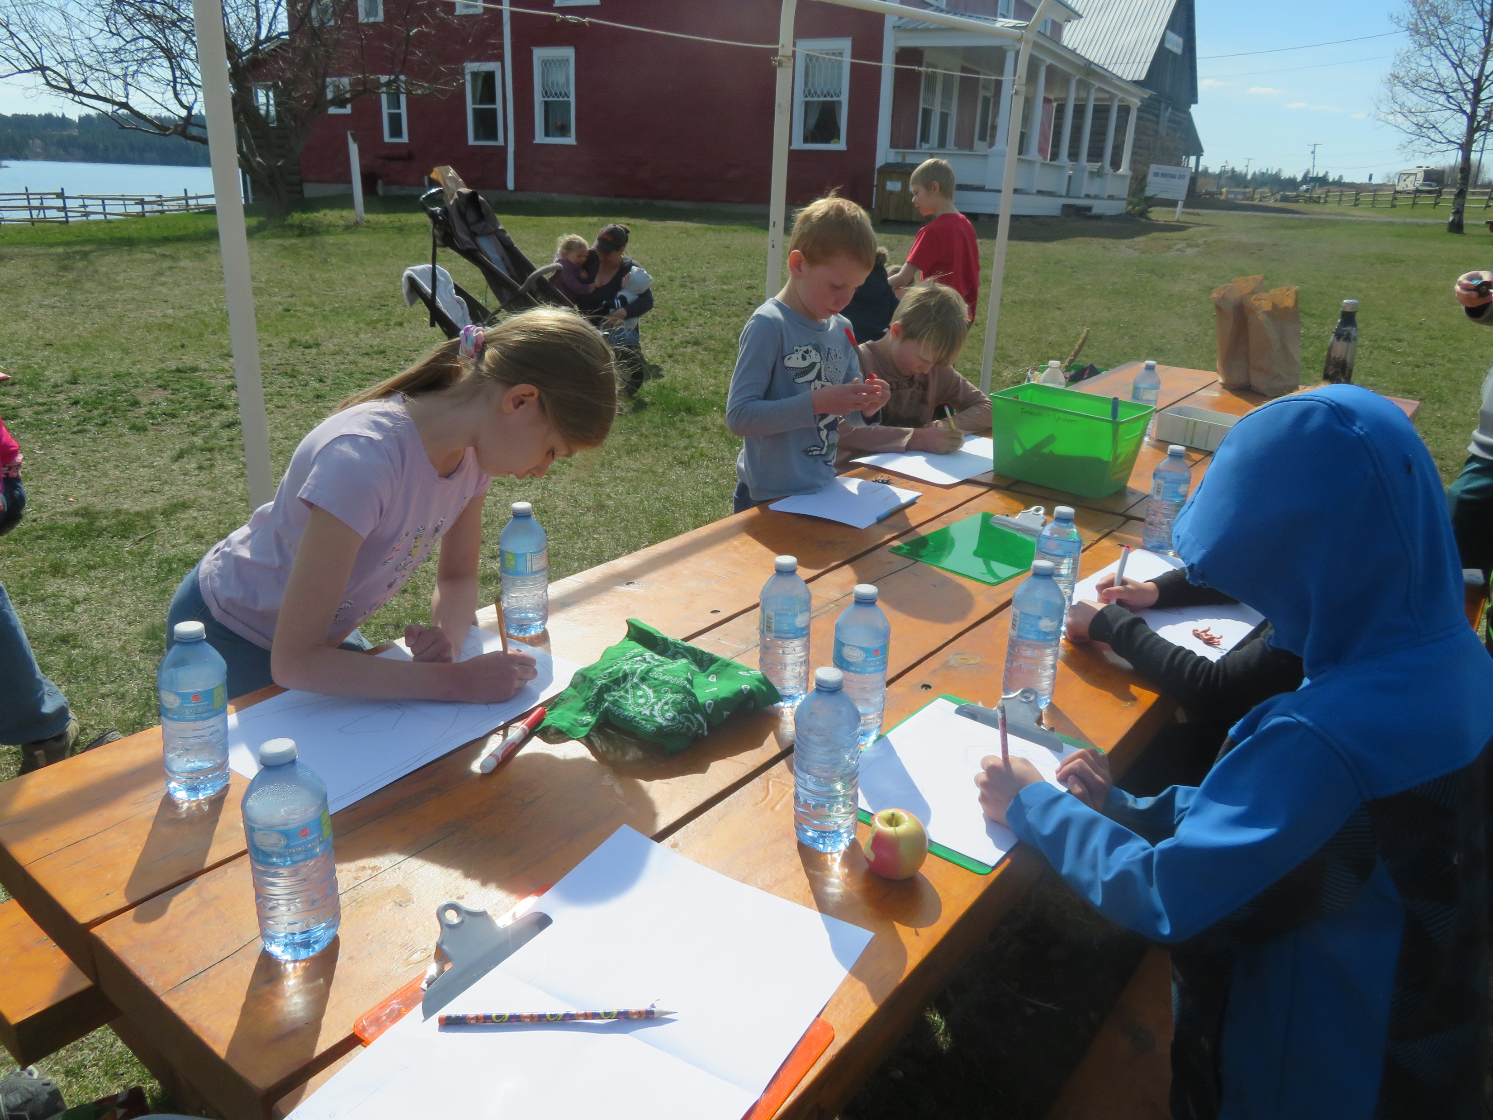
April 19th Event
We had a very good turn out for our south end field trip on April 19th. Our first stop was to the 108 Mile Fire Department for a great tour given by Bill Warden and two other members of the fire department. After a wonderful lunch provided by the PAC at the 108 Mile Heritage Site, we learned how to play ultimate frisbee, led by Matt Ziemer. Then we had a presentation about invasive species by Emma from the Invasive Species Council of BC. Students also tried their hand at creating treasure maps for their friends. It was a full day of learning and community, and fun was had by everyone.
Term 3 Work Submissions
Term 2 work submissions are due at GROW on June 1st. This gives Jillian time to go over your child’s work samples and contact you if needed before writing report cards. Work can be submitted as hard copies to GROW or electronically through Teams. Please let Jillian know if you have any questions.
Ongoing Access to Community Services
We just wanted to remind everyone, and let new enrollments know, about our agreements with community organizations for GROW students:
Swimming – GROW students may swim free from 9:00am-3:00pm, Mon-Fri at the pool in Williams Lake.
Gym Time – if you would like gym time, let us know! The gym at Lac La Hache Elementary can be made available for GROW students starting at 2:00pm on school days. Gym time has to be booked in advance.
Drop-In at GROW – We continue to have a drop-in day for GROW students every Friday. Come by if you’d like some extra support, a resource, or would just like to show your face and say hi!

